Slide 1
Is Kyrie Irving Underpaid?
By: Yassin Serageldin

Slide 2
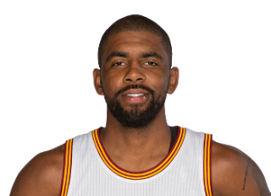
Basketball is my favourite sport.
Kyrie Irving is my favorite basketball player
I want to prove that he is underpaid

Slide 3
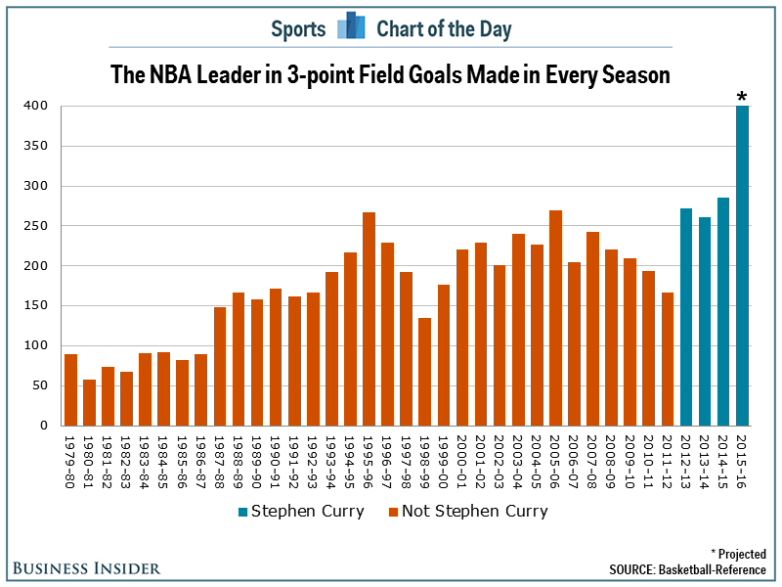
What is my Data?
Minutes played per game
Points
Assists
Rebounds
Blocks
Free Throw %
3 Point %
Field Goal %

Slide 4
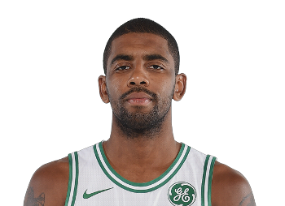
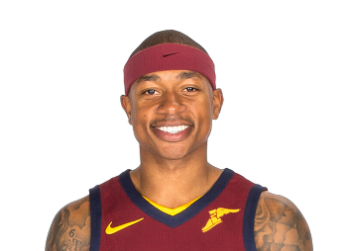
Comparisons
I needed to compare Kyrie’s statistics with other players
I chose Russell Westbrook and Isaiah Thomas because they are similar in ability

Slide 5
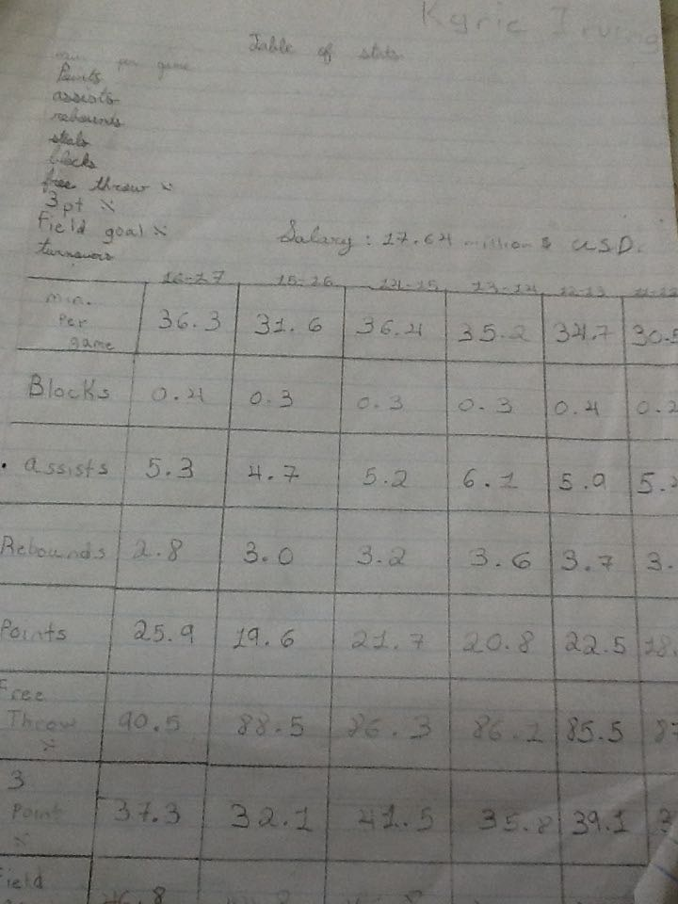
Raw Data
Kyrie Irving
Salary:

Slide 6
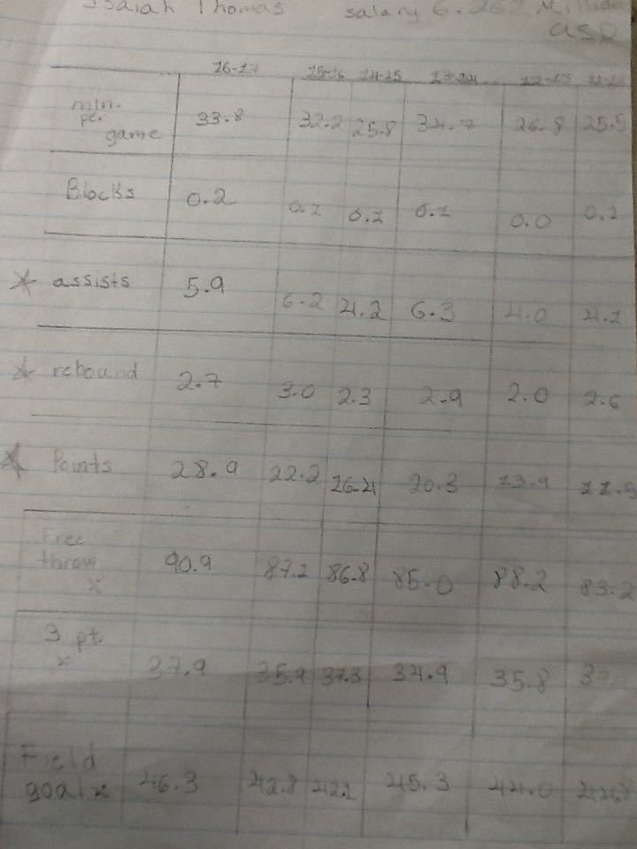
Raw Data
Isaiah Thomas
Salary:

Slide 7
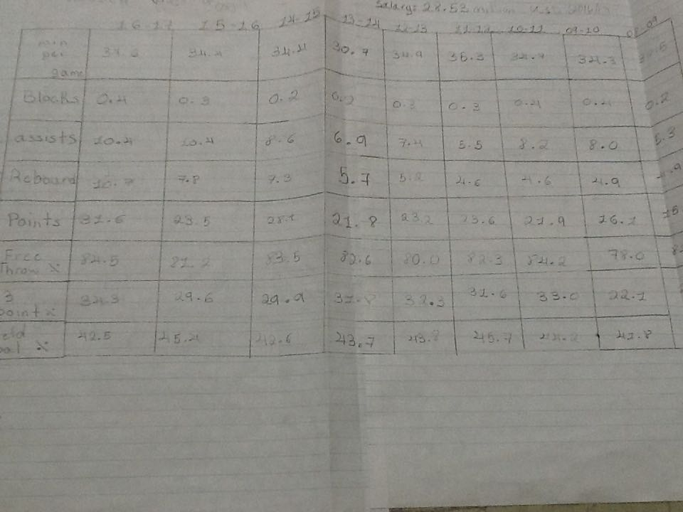
Raw Data
Russell Westbrook
Salary:

Slide 8
Players Salaries
Kyrie Irving: 17.64 mill. $
Isaiah Thomas: 6.26 mill. $
Russell Westbrook: 28.53 mill. $

Slide 9
Processed Data
With my data, I did different types of math to help me determine my answer
I chose the 3 most important statistics to create a career average
Points
Rebounds
Assists
Averaged 3 players salaries
Ratio chart of each averaged statistic for the 3 players
Average chart to see who is above and below average compared to each other

Slide 10
Math

Slide 11
Math

Slide 12
Math

Slide 13
Math

Slide 14
Math

Slide 15
Math

Slide 16
Math

Slide 17
Kyrie Irving
Assists: Salary | 5:18
Points: Salary | 22:18
Rebounds: Salary | 3:18
Salary
17.64 18 (million)

Slide 18
Russell Westbrook
Assists: Salary | 8:29
Points: Salary | 23:29
Rebounds: Salary | 6:29
Salary
28.53 29 (million)

Slide 19
Isaiah Thomas
Assists: Salary | 5:6
Points: Salary | 18:6
Rebounds: Salary | 3:6
Salary
6.26 6 (million)

Slide 20
Average Chart
(career average : average)
Stat | K. Irving | R. Westbrook | I. Thomas
Assists | 5:6 | 8:6 | 5:6
Points | 22:21 | 23:21 | 18:21
Rebounds | 3:4 | 6:4 | 3:4

Slide 21
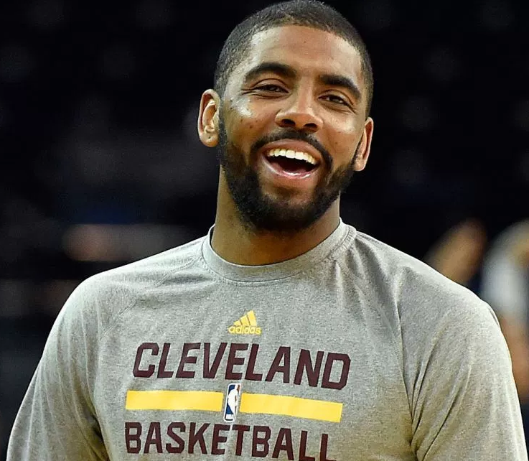
Conclusion
In comparison with the other players in Kyrie’s caliber he is being paid appropriately for the time being

Slide 22
How?
To prove my conclusion I referred back to this Average chart
As you can see Russell Westbrook is above average for each stat and that Isaiah Thomas is below average for each stat
But Kyrie Irving is about average for each stat
Which means he is in the middle
So I can prove that he is being paid appropriately
Stat | K. Irving | R. Westbrook | I. Thomas
Assists | 5:6 | 8:6 | 5:6
Points | 22:21 | 23:21 | 18:21
Rebounds | 3:4 | 6:4 | 3:4

Slide 23
Thank you
Thank you to www. foxsports. com/nba/kyrie-irving-player-stats
which is where I found my stats for K. Irving, I. thomas, and R. Westbrook.

