Slide 1
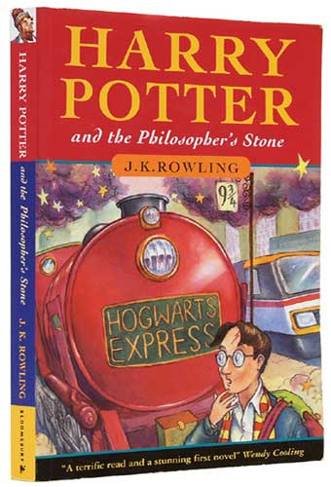
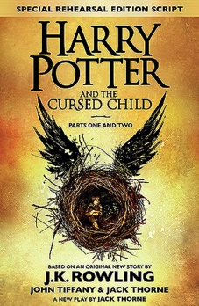
Is J.K Rowling worth her net worth?
BY:TABITHA LINDSAY

Slide 2
Why did I chose this question ?
I love to read her books and read in general
I want to be able to show my parents how much math goes into one simple question

Slide 3
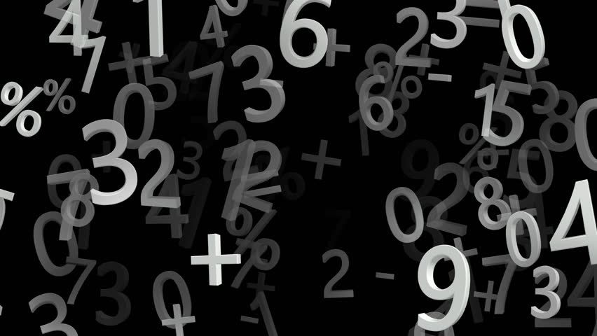
Raw Data
- Raw data is all the data that I collected to use for my math inquiry
I collected:
- net worth, awards won and the number of books written by J.K Rowling and other authors

Slide 4
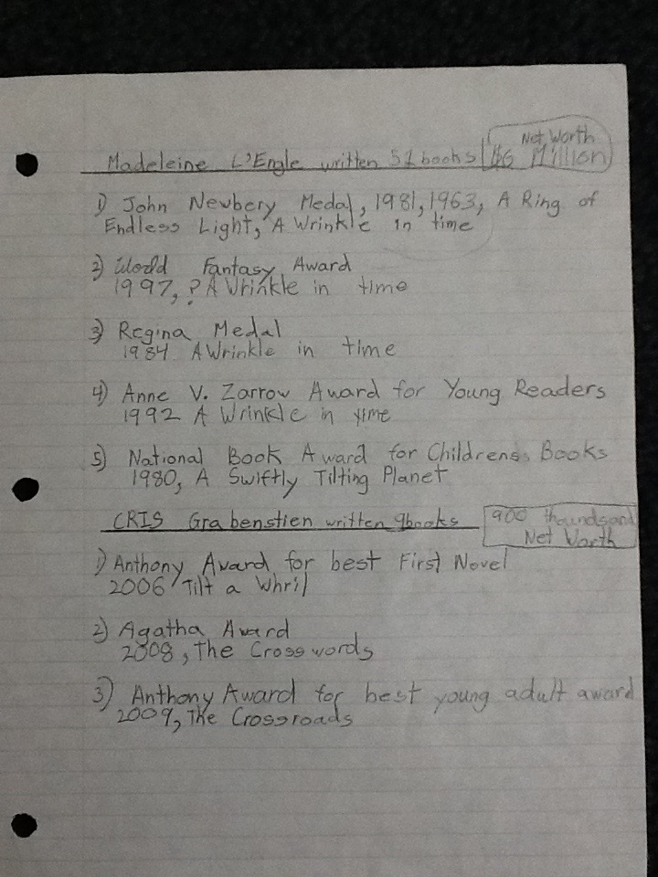
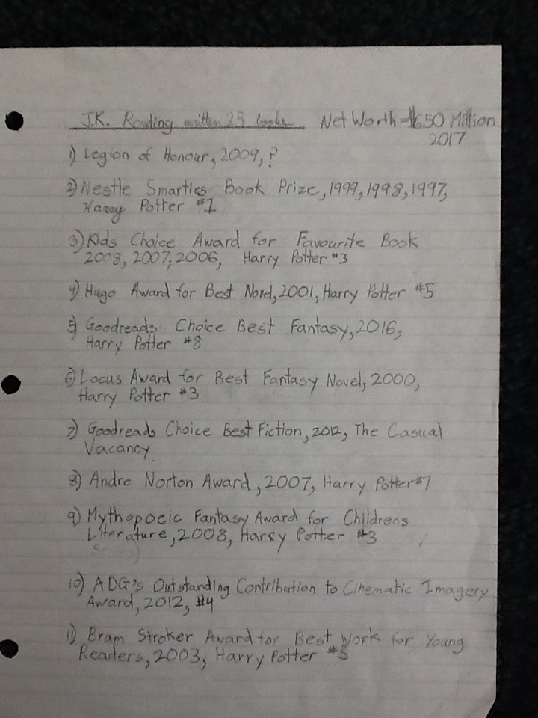
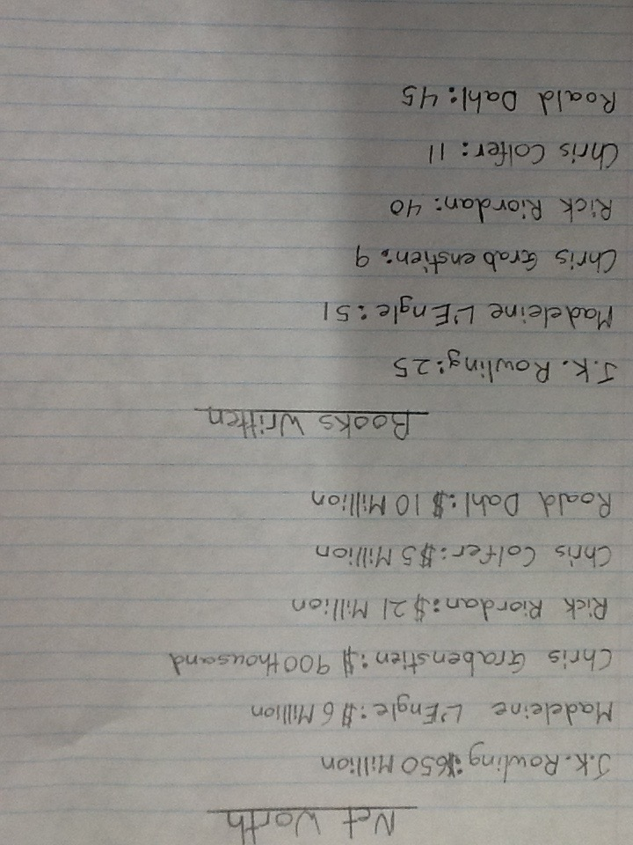
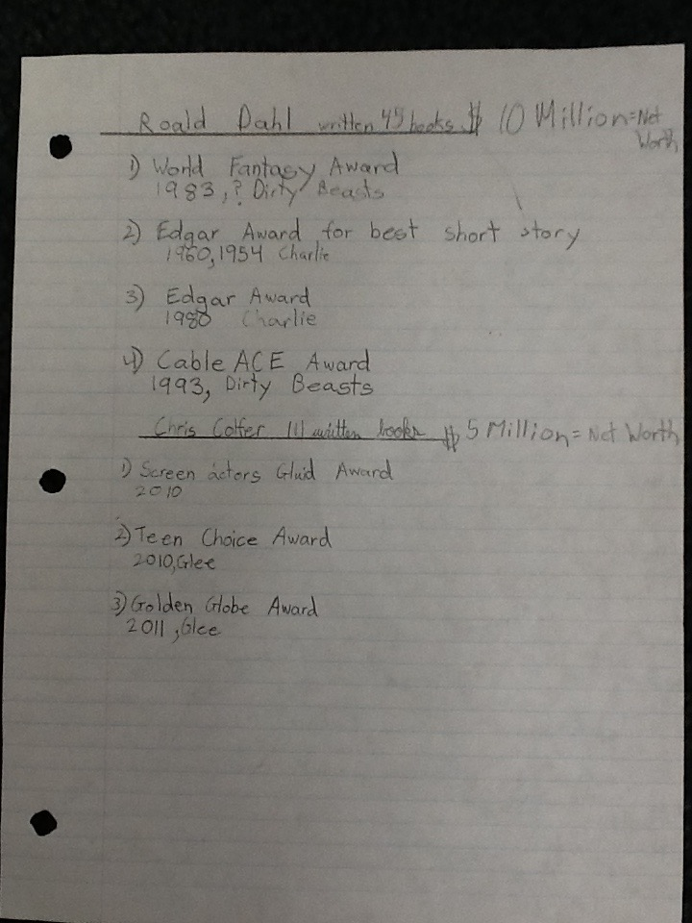

Slide 5
Calculated Data
-Once I found my Raw data I started using it to make calculated data
I found :
- Percentages (0%)
- Fractions (0/0)
- Decimals (0.0)
- Ratios (0:0)

Slide 6
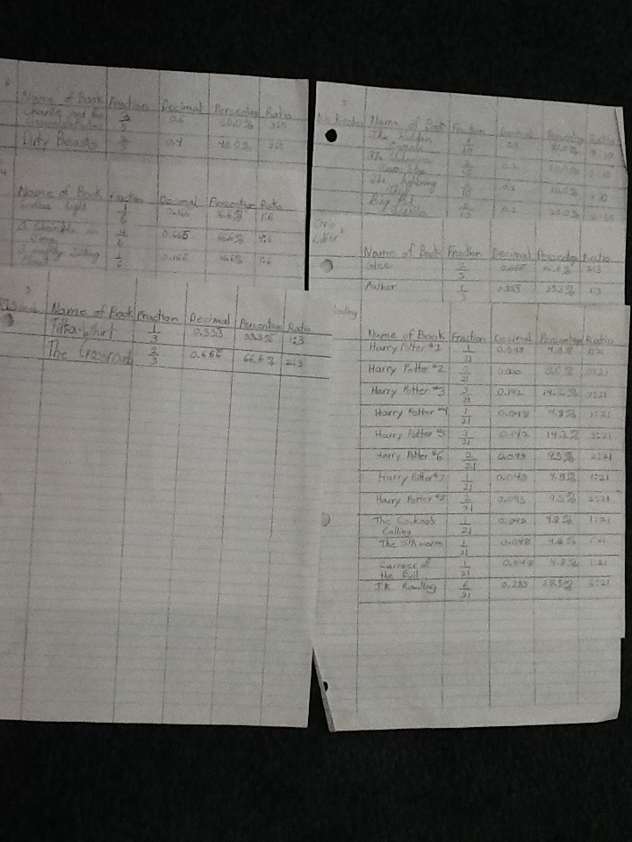

Slide 7
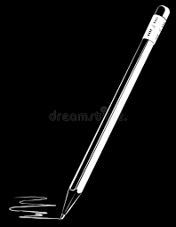
Rough Work
-In order to find all the calculated data I had lots of rough work

Slide 8
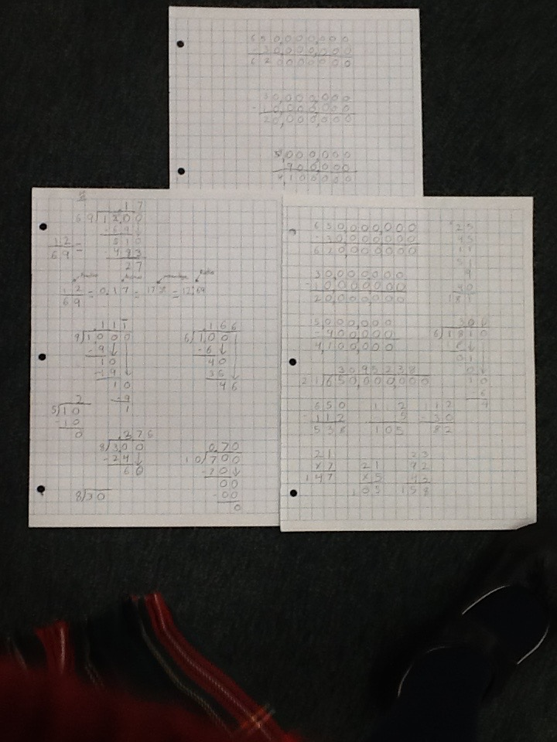

Slide 9
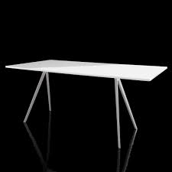
Tables
- For this project I had to keep myself organized
- I put all my calculated data into a table

Slide 10
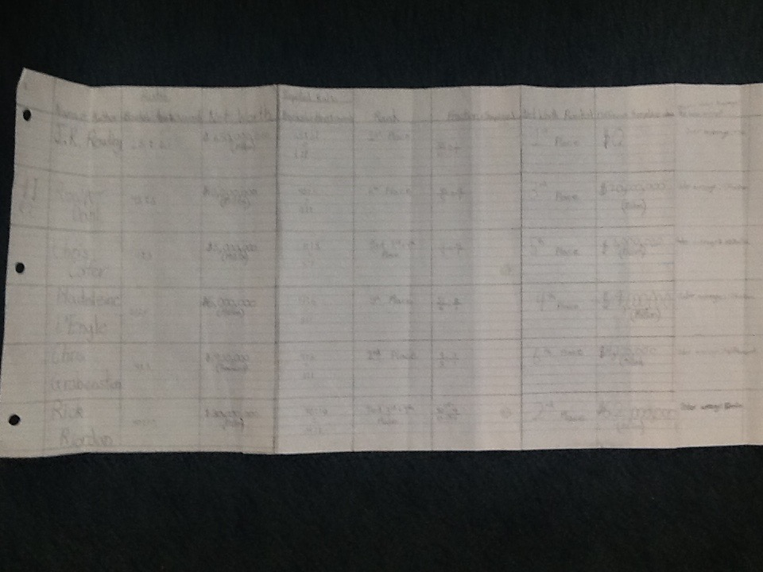

Slide 11
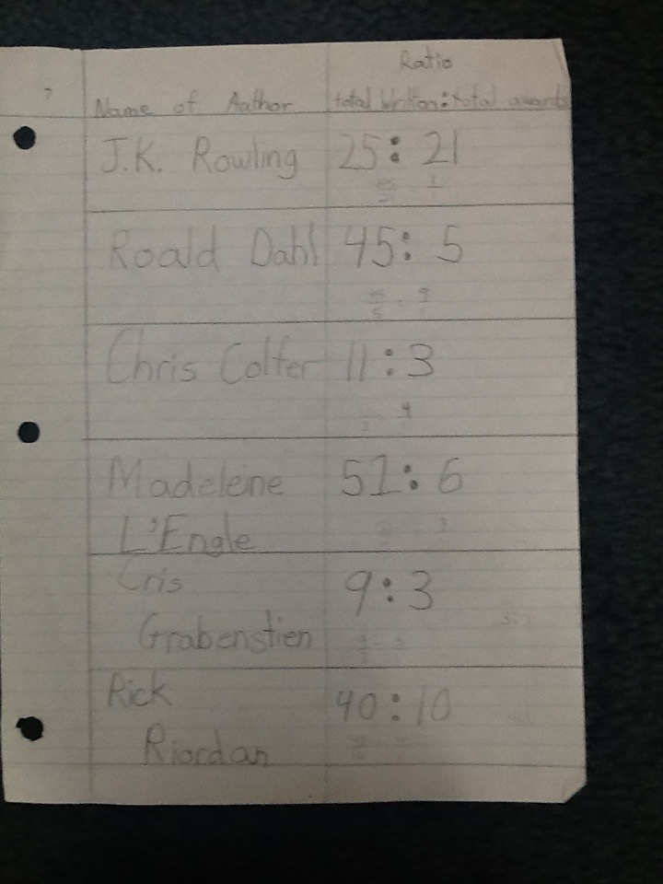

Slide 12
Name of Author | Books Written: Awards | Simplified Ratios | Net Worth | Net Worth Ranked | Difference from place above | Under or over average (Net Worth)
J.K Rowling | 25:21 | 1:1 | 650 million | 1st | $0 | Over:538 Million
Roald Dahl | 45:5 | 9:1 | 10 million | 3rd | $20 Million | Under:102 Million
Chris Colfer | 11:3 | 4:1 | 5 million | 5th | $1Million | Under:107 Million
Madeline L’Engle | 51:6 | 8:1 | 6 million | 4th | $4Million | Under:106 Million
Chris Grabenstien | 9:3 | 3:1 | 900 thousand | 6th | $4million | Under:111 Thousand
Rick Riordan | 40:10 | 4:1 | 30 million | 2nd | $62Million | Under:82 Million

Slide 13
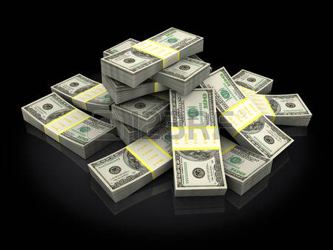
Conclusion
“Is J.K Rowling worth her net worth?”
I compared J.K Rowling with 5 other authors
I collected the same information for all six authors

Slide 14
J.K Rowling is worth her net worth
She has the highest net worth but as you can see she has won an award for almost every book she has written (1:1 ratio).
Name of Author | Books Written: Awards | Simplified Ratios | Net Worth | Net Worth Ranked
J.K Rowling | 25:21 | 1:1 | 650 million | 1st

Slide 15
Rick Riordan | 40:10 | 4:1 | 30 million | 2nd
For example Rick Riordan has the second highest net worth, but he has to write four books to receive one award.

